Slide 1
Comprehensions(List,Dictionary) Sparse matrices, aliasing and copying L14,L16 and L17

Slide 2
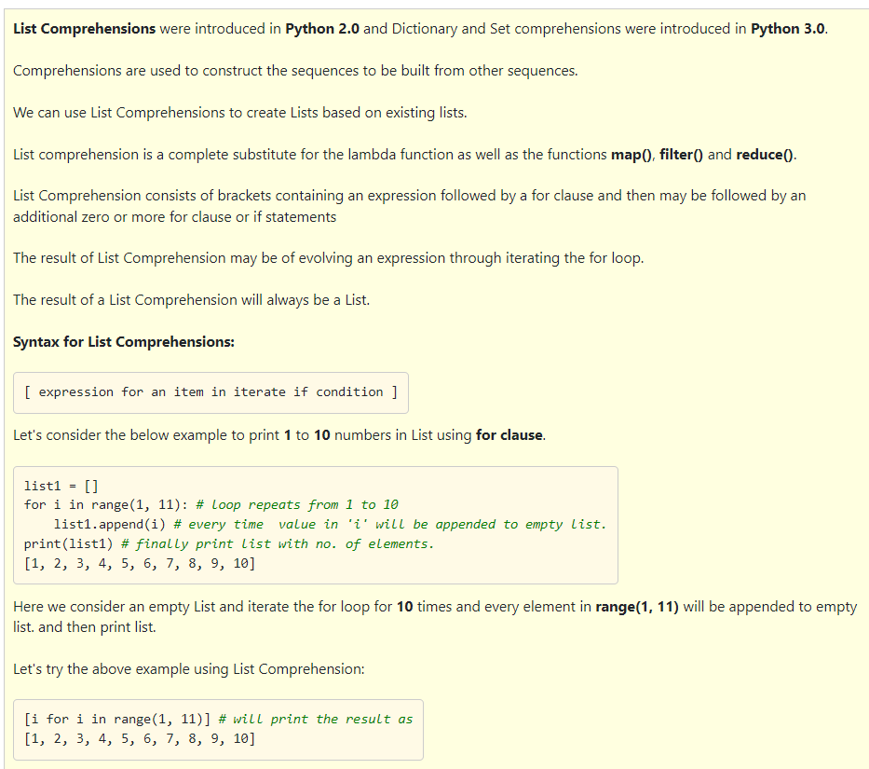

Slide 3
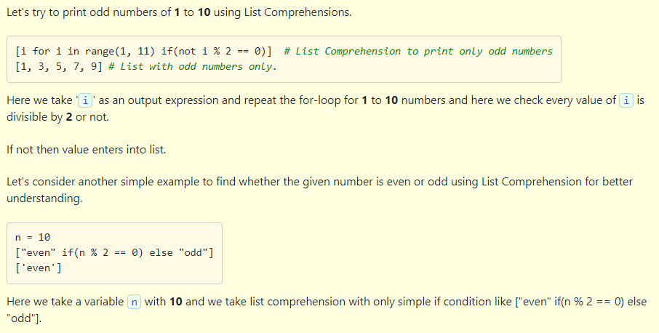

Slide 4
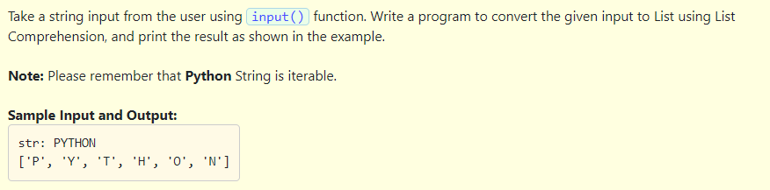
#Program illustrating simple list comprehension
data = input("str: ")
l1 = [i for i in data]
print(l1)

Slide 5
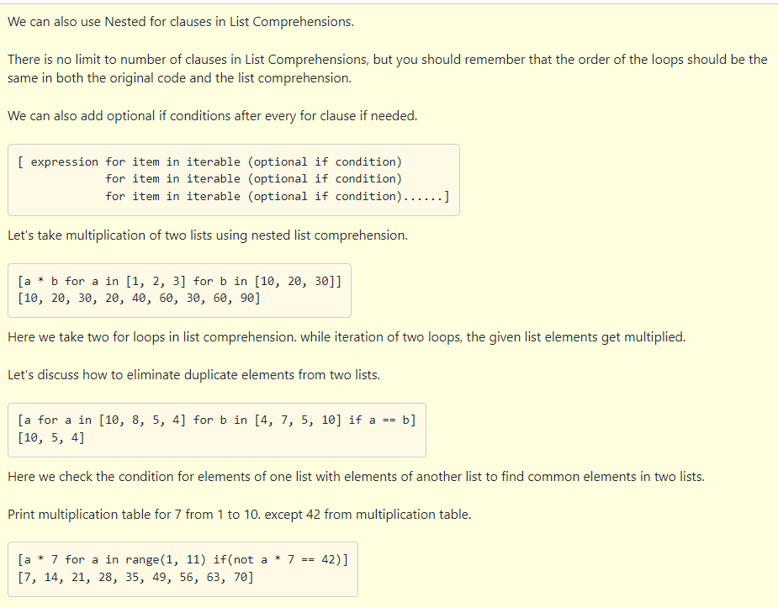

Slide 6
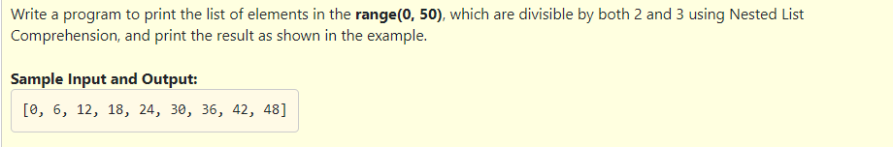
#Program to illustrate Nested List Comprehension
L1 = [a for a in range(50) if a % 2 == 0 if a % 3 == 0]
print(L1)

Slide 7
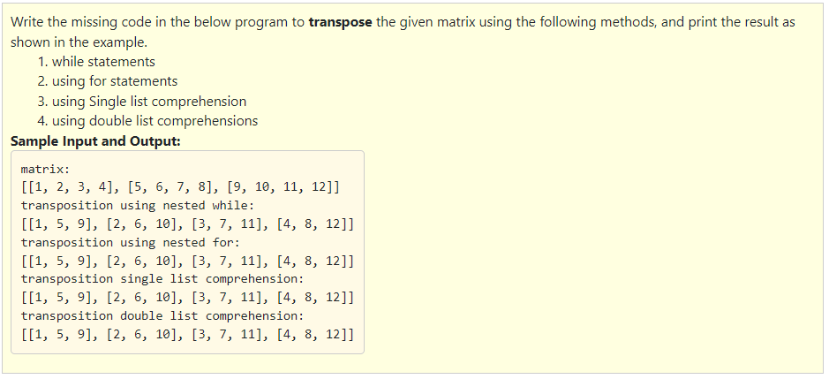

Slide 8
#Program to transpose a matrix in different ways
matrix = [[1, 2, 3, 4], [5, 6, 7, 8], [9, 10, 11, 12]]
transposed = []
print("matrix:")
print(matrix)
print("transposition using nested while:")
""" Matrix Transposition using Nested while"""
i = 0
while(i < len(matrix[0])):
j = 0
lx = []
while(j < len(matrix)):
lx.append(matrix[j][i])
j = j + 1
transposed.append(lx)
i = i + 1
print(transposed)
print("transposition using nested for:")
""" Matrix Transposition using Nested Fors"""
transposed = [] # Transposed Matrix
for i in range(len(matrix[0])):
transposed_row = []
for row in matrix: # Build each row
transposed_row.append(row[i])
transposed.append(transposed_row) # Append the row
print(transposed)
print("transposition single list comprehension:")
""" Matrix Transposition using single list comprehension"""
transposed = []
#list comprehension used to build the row
for i in range(len(matrix[0])):
transposed.append([row[i]for row in matrix])
print(transposed)
print("transposition double list comprehension:")
""" Matrix Transposition using double list comprehension"""
#list comprehension used to build the row and column
trasposed = []
transposed = [[row[i]for row in matrix]for i in range(len(matrix[0]))]
print(transposed)

Slide 9
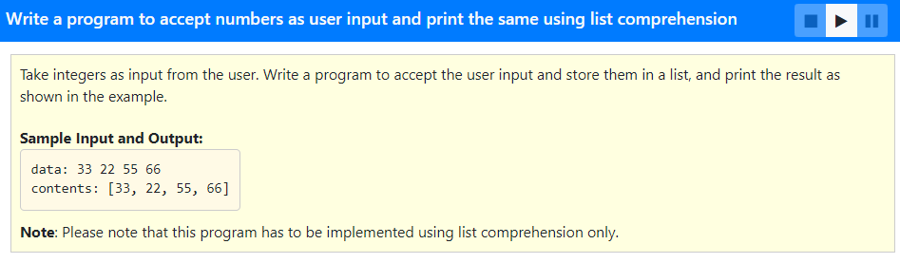
list1 = [int(x) for x in input("data: ").split()]
print("contents:", list1)

Slide 10
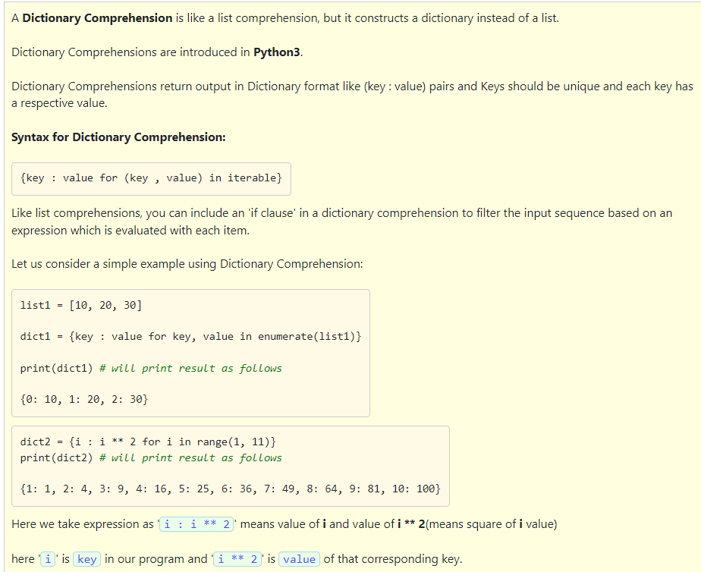

Slide 11
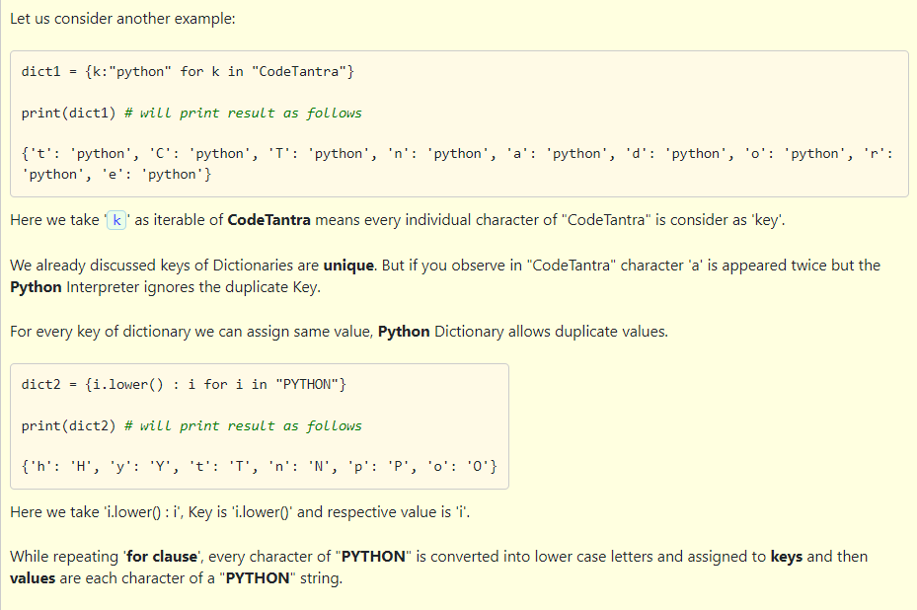

Slide 12
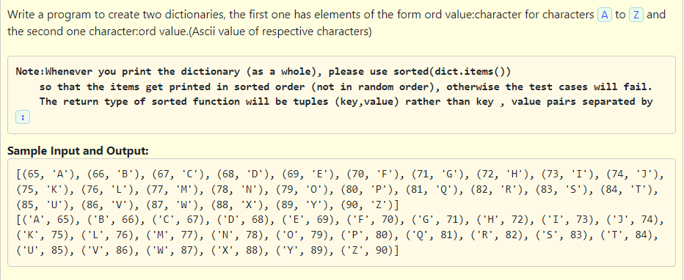

Slide 13
#Program to illustrate Dict comprehension
ordchar = {x:chr(x) for x in range(65, 91)}
charord = {x:y for y, x in ordchar.items()}
print(sorted(ordchar.items()))
print(sorted(charord.items()))

Slide 14
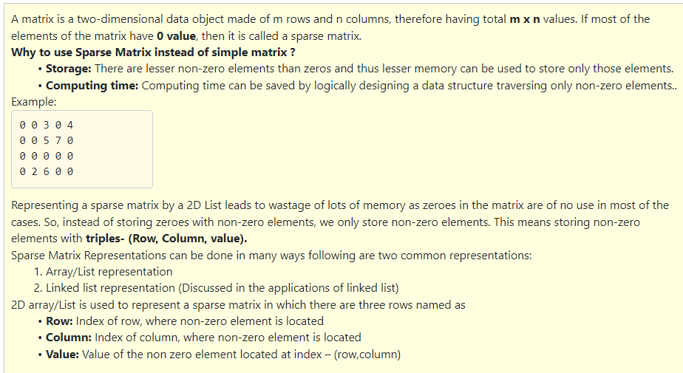

Slide 15
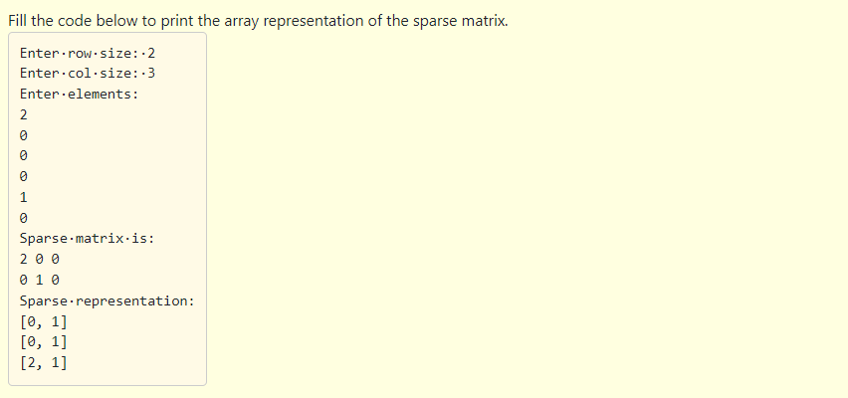
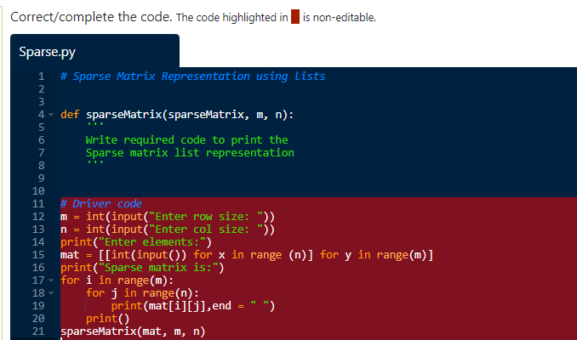

Slide 16
# Sparse Matrix Representation using lists
def sparseMatrix(sparseMatrix, m, n):
# initialize size as 0
size = 0
for i in range(m):
for j in range(n):
if (sparseMatrix[i][j] != 0):
size += 1
# number of columns in compressMatrix(size) # should be equal to number of # non-zero elements in sparseMatrix
rows, cols = (3, size)
compressMatrix = [[0 for i in range(cols)] for j in range(rows)]
k = 0
for i in range(m):
for j in range(n):
if (sparseMatrix[i][j] != 0):
compressMatrix[0][k] = i
compressMatrix[1][k] = j
compressMatrix[2][k] = sparseMatrix[i][j]
k += 1
print("Sparse representation:")
for i in compressMatrix:
print(i)
m = int(input("Enter row size: "))
n = int(input("Enter col size: "))
print("Enter elements:")
mat = [[int(input()) for x in range (n)] for y in range(m)]
print("Sparse matrix is:")
for i in range(m):
for j in range(n):
print(mat[i][j],end = " ")
print()
sparseMatrix(mat, m, n)

Slide 17
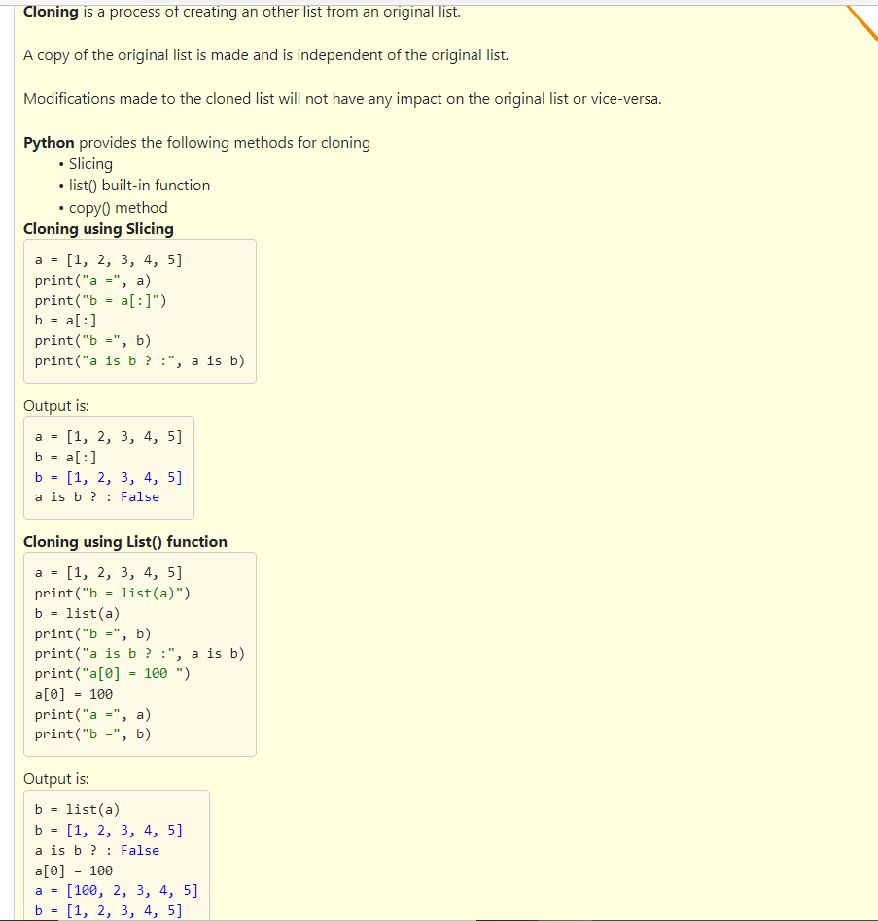
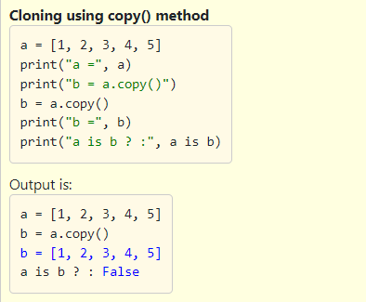

Slide 18
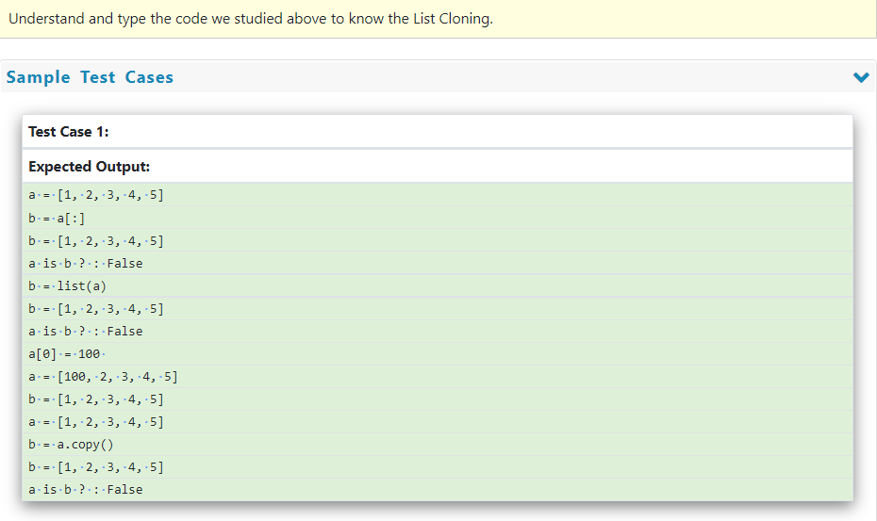

Slide 19
#cloning using slicing
a = [1, 2, 3, 4, 5]
print("a =", a)
print("b = a[:]")
b = a[:]
print("b =", b)
print("a is b ? :", a is b)
#cloning using list function
a = [1, 2, 3, 4, 5]
print("b = list(a)")
b = list(a)
print("b =", b)
print("a is b ? :", a is b)
print("a[0] = 100 ")
a[0] = 100
print("a =", a)
print("b =", b)
#cloning using copy method
a = [1, 2, 3, 4, 5]
print("a =", a)
print("b = a.copy()")
b = a.copy()
print("b =", b)
print("a is b ? :", a is b)

